Slide 1
Generalizing Skills With Semi-Supervised Reinforcement Learning
Chelsea Finn, Tianhe Yu, Justin Fu, Pieter Abbeel, Sergey Levine
† Berkeley AI Research (BAIR), University of California, Berkeley
‡ OpenAI
{cbfinn,tianhe.yu,justinfu,pabbeel,svlevine}@berkeley.edu
Published as a conference paper at ICLR 2017

Slide 2
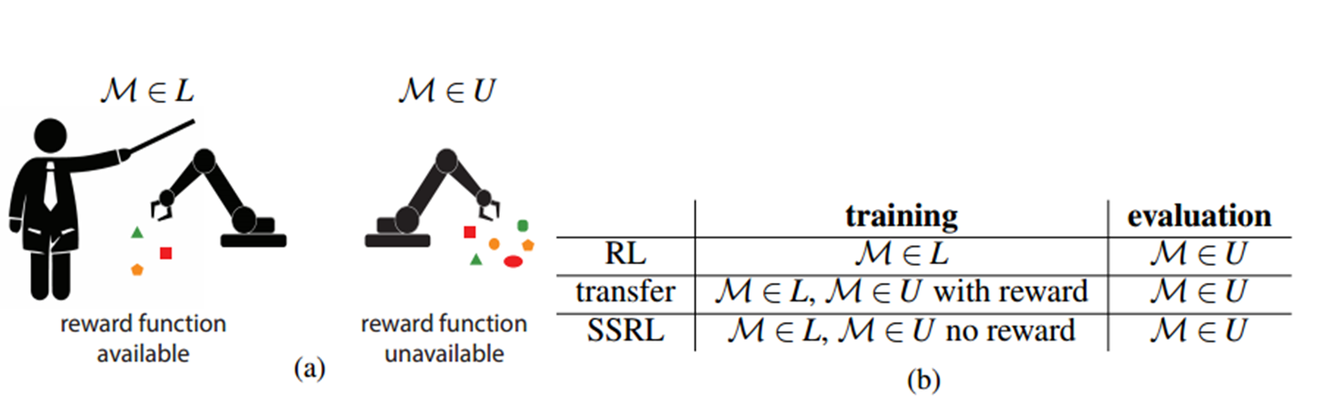
Problem : learning requires access to a reward function, Such reward functions are often hard to measure in the real world, especially in domains such as robotics and dialog systems
Ssrl : the reward function can only be evaluated in a set of “labeled” MDPs, and the agent must generalize its behavior to the wide range of states it might encounter in a set of “unlabeled” MDPs, by using experience from both settings.

Slide 3
Different reinforcement learning approach
Standard paradigm : learn a policy in the labeled MDPs and apply it directly to new MDPs from the same distribution
Alternative approach(more effective) : train a reward function with supervised learning to regress from the agent’s observations to the reward labels , and then use this reward function for learning in the unlabeled settings. Ssrl : the state distributions in the two sets of MDPs may be different, a function approximator trained on the reward function in the labeled MDPs may not necessarily generalize well to the unlabeled one, due to the domain shift. A more effective solution would be to incorporate the unlabeled experience sampled from U when learning the reward

Slide 4
Transfer learning : use prior experience in one domain to improve training performance in another
IRL : learn reward functions from expert, human demonstrations, typically with the end goal of learning a policy that can succeed from states that are not in the set of demonstrations
Algorithm : semi-supervised skill generalization (S3G) , use IRL to infer the reward function underlying a policy previously learned in a small set of labeled scenarios, rather than using expert demonstrations. train an RL policy in settings where a reward function is available, and then run an algorithm that resembles inverse reinforcement learning, to simultaneously learn a reward and a more general policy in the wider range of unlabeled settings

Slide 5
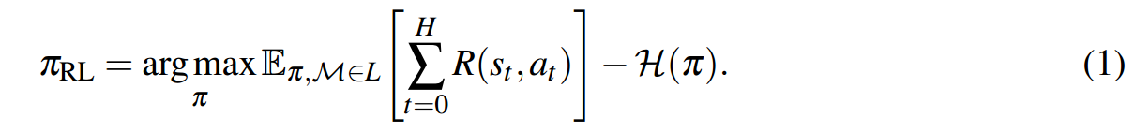
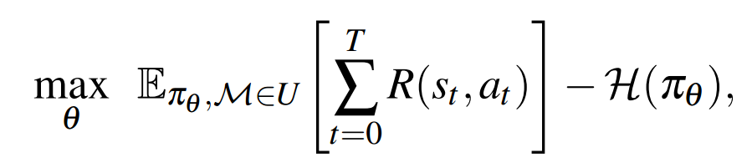
SEMI-SUPERVISED SKILL GENERALIZATION
optimize an entropy-regularized objective :
use the framework of maximum entropy control, this framework helps to produce policies in the labeled MDP that are diverse, and therefore better suited for inferring reward functions that transfer effectively to the unlabeled MDP.
After training πRL, we generate a set of samples from πRL in L, which we denote as DπRL. The objective of S3G is to use DπRL to find a policy that maximizes expected reward in U, where the reward R is not available.

Slide 6
SEMI-SUPERVISED SKILL GENERALIZATION
S3G simultaneously learns a reward function R˜φ with parameters φ and optimizes a policy πθ with parameters θ in the unlabeled MDP U. This consists of iteratively taking samples Dπθ from the current policy πθ in U, updating the reward R˜φ , and updating the policy πθ using reward values imputed using R˜φ . At the end of the procedure, we end up with a policy πθ optimized in U.
1、Reward update
2、Policy update

Slide 7
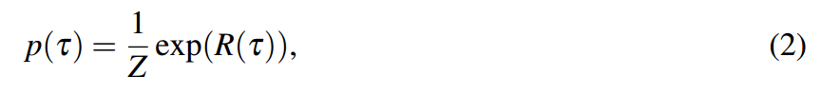
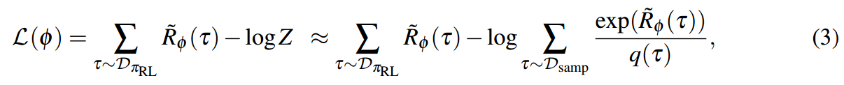
SEMI-SUPERVISED SKILL GENERALIZATION
Reward update : Because of the entropy regularized objective in Equation 1, it follows that the samples DπRL are generated from the following maximum entropy distribution :
τ : a single trajectory sample {s0,a0,s1,a1,...,sT } R(τ) = ∑t R(st,at) the objective of the reward optimization phase is to maximize the log likelihood of the agent’s prior experience DπRL under this exponential model . thus use importance sampling, using samples to estimate the partition function Z as follows:
set Dsamp to be {Dπθ U DπRL} , q(τ) is the probability of sampling τ under the policy it was generated from .

Slide 8
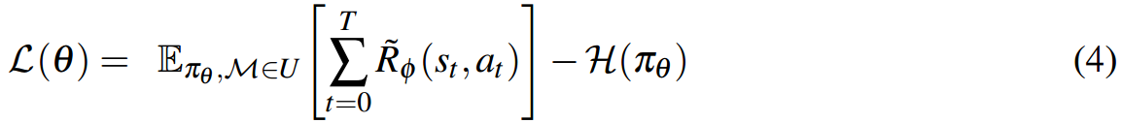
SEMI-SUPERVISED SKILL GENERALIZATION
Policy update : the goal with the policy is two-fold :1)、need a policy that succeeds in MDPs M ∈ U. 2)、 the policy must also serve to generate samples for more accurately estimating the partition function in Equation 2 .
The policy optimization objective is to maximize an entropy term as before:
The paper uses mirror descent guided policy search (MDGPS), a sample-efficient policy optimization method suitable for training complex neural network policies that has been validated on real-world physical robots in this step .

Slide 9
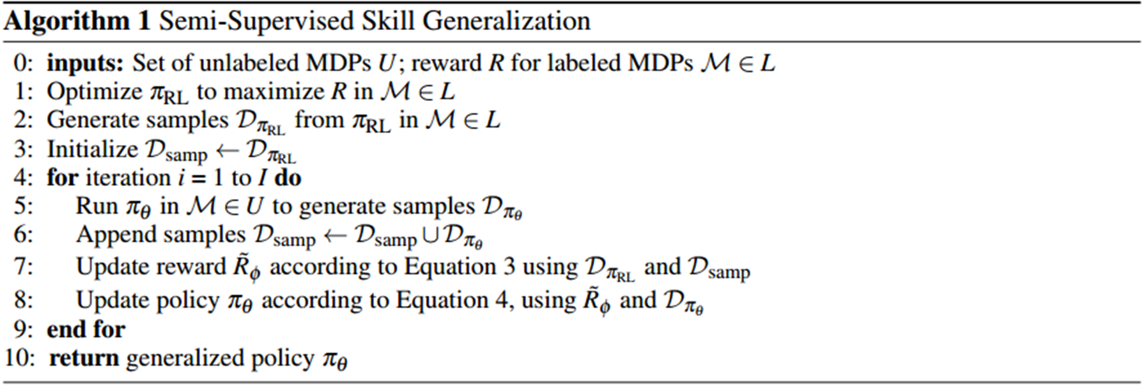
SEMI-SUPERVISED SKILL GENERALIZATION

Slide 10
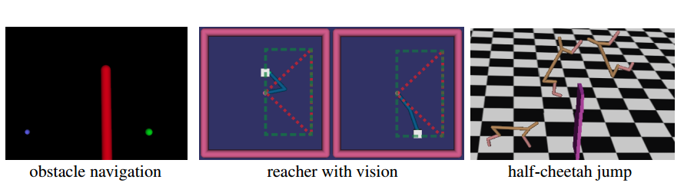
Experimental

Slide 11

Task
1 obstacle navigation : navigate a point robot around an obstacle to a goal position in 2D
observation : robot’s position and velocity, does not include the height of the obstacle
obstacle height :
in labeled MDP : 0.2
in unlabeled MDP : 0.5

Slide 12
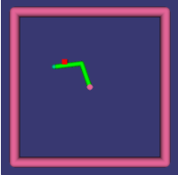
Task
2 2-link reacher : moving the end-effector of a two-link reacher to a specified goal position
observation : robot’s joint angles, end-effector pose, and their timederivatives mass :
in labeled MDP : varies between 7×10-9 and 7×101
in unlabeled MDP : varies between 7× 10-9 and 7× 103

Slide 13
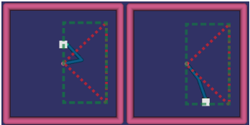
Task
3 2-link reacher : is the same as the 2-link reacher, except, in this task, the MDPs involve a wide 2D range of target positions
observation : robot’s joint angles, end-effector pose, and their timederivatives
input : a raw 64× 80 RGB image of the environment

Slide 14
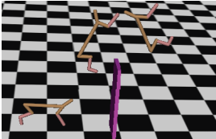
Task
4 half-cheetah jump : for a simulated 6-DOF cheetah-like robot with to jump over a wall, with 10% gravity
observation : robot’s joint angles, global pose, and their velocities, for a total dimension of 20 wall height :
in labeled MDP : 0.2m
in unlabeled MDP : 0.5m

Slide 15
Task
In all tasks, the continuous action vector corresponds to the torques or forces applied to each of the robot’s joints. For the first three tasks, reaching the goal position within 5 cm is considered a success. For the non-visual tasks, the policy was represented using a neural network with 2 hidden layers of 40 units each. The vision task used 3 convolutional layers with 15 filters of size 5×5 each, followed by the spatial feature point transformation. The reward function architecture mirrored the architecture as the policy, but using a quadratic norm on the output

Slide 16
Evaluation
compare the performance to that :
RL policy : the RL policy πRL, trained only in the labeled MDPs
Reward regression : a policy learned using a reward function fitted with supervised learning
Oracle policy : an oracle policy which can access the true reward
function in all scenarios

Slide 17
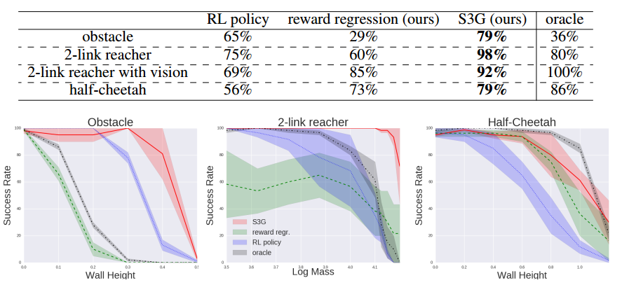
Evaluation
The code is available at : github.com/cbfinn/gps/tree/ssrl
Videos of the learned policies : sites.google.com/site/semisupervisedrl

Slide 18
Reset-Free Guided Policy Search: Efficient Deep Reinforcement Learning with Stochastic Initial States
William Montgomery, Anurag Ajay, Chelsea Finn, Pieter Abbeel, and Sergey Levine
IEEE International Conference on Robotics and Automation 2017

Slide 19
Problem : We have proposed a new reinforcement learning algorithm (Guided Policy Search , GPS) that can train general-purpose neural network policies with minimal human engineering, while still allowing for fast, efficient learning in stochastic environments .
THE PARER : In contrast to prior GPS methods, which require a consistent set of initial states to which the system must be reset after each episode, our approach can handle random initial states, allowing it to be used even when deterministic resets are impossible.

Slide 20
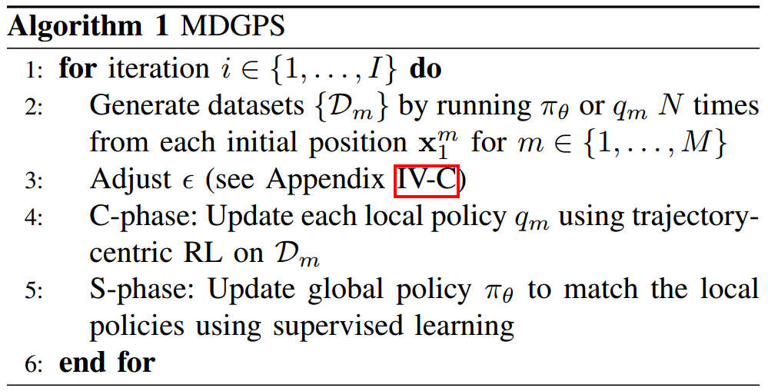
mirror descent guided policy search (MDGPS) algorithm

Slide 21
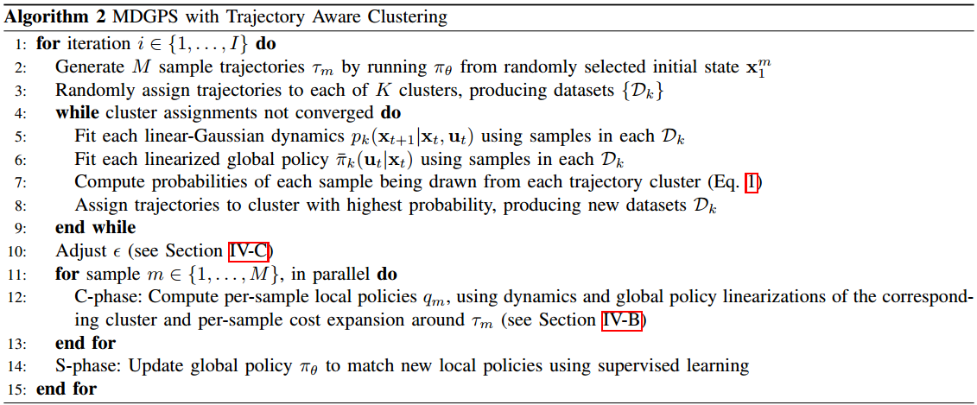
MDGPS with Trajectory Aware Clustering

Slide 22
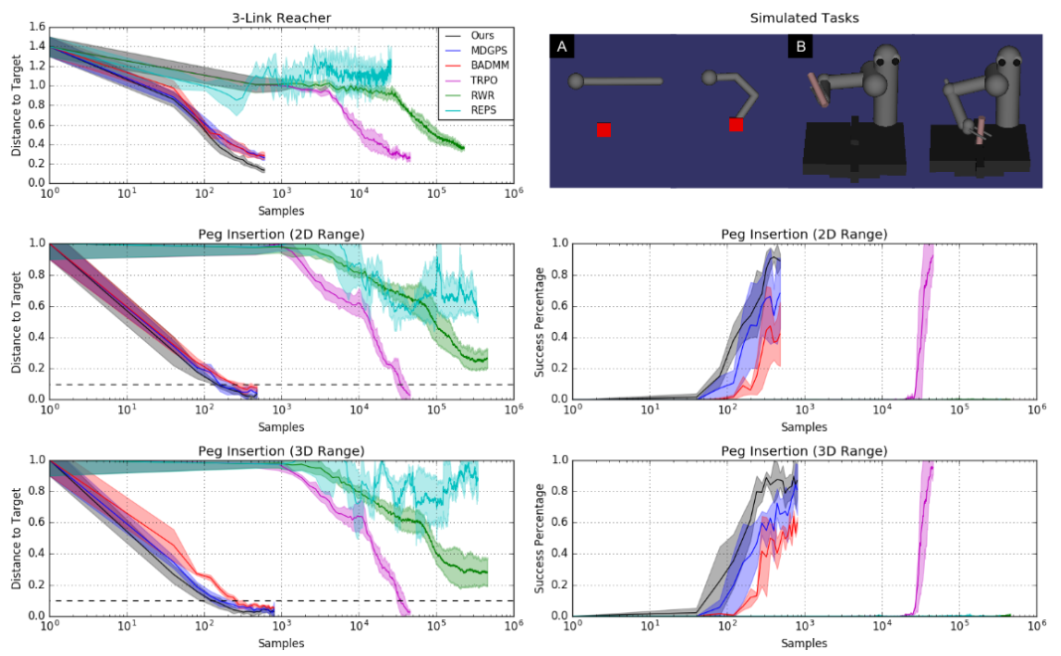
Fig. 1. Simulated comparisons

Slide 23
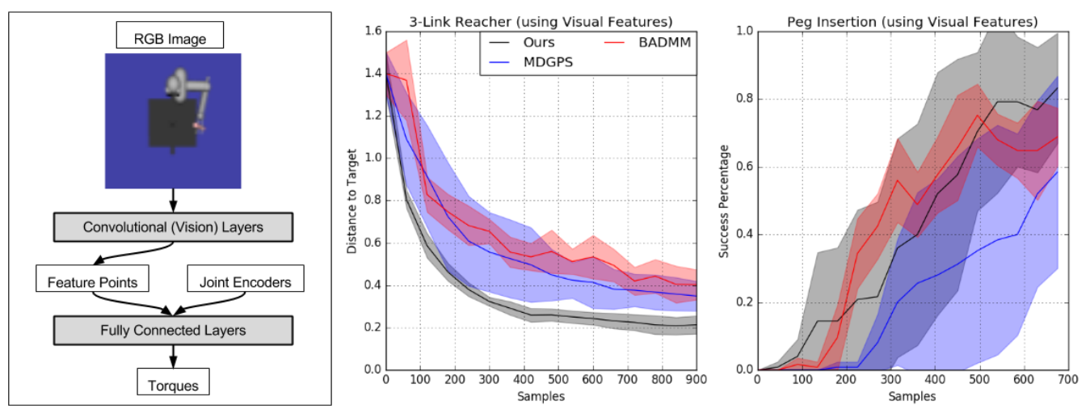
Fig. 2. Learning from raw pixels

Slide 24
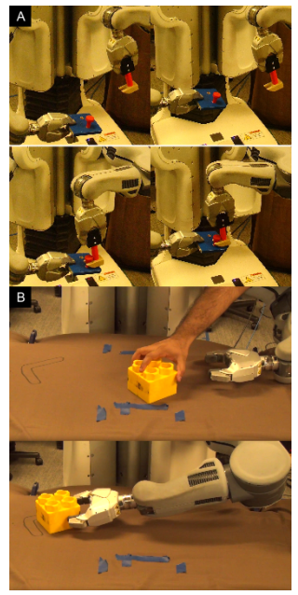
Fig. 3. PR2 tasks
Video recordings of the robot learning process and the final policy : http://sites.google.com/site/resetfreegps

Slide 25
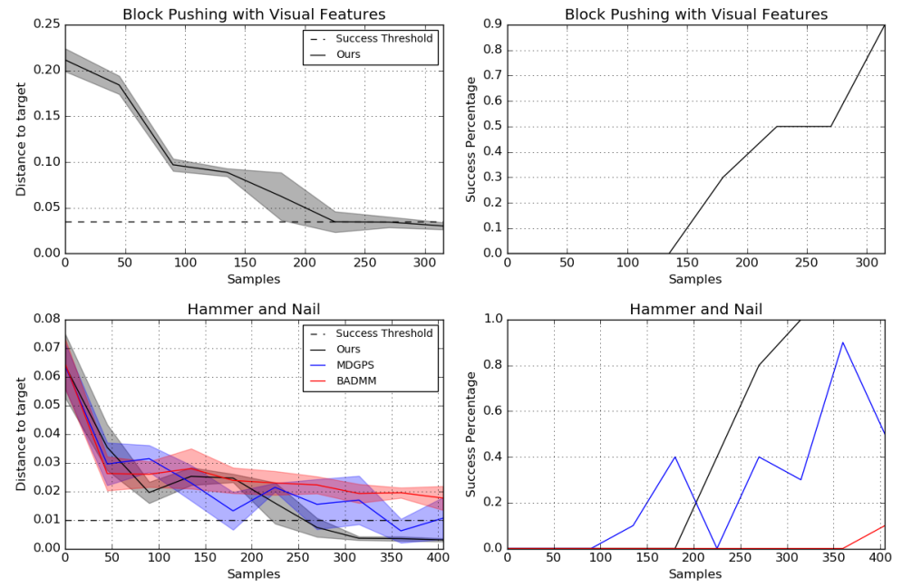
Fig. 4. Real-world robotic results

